Slide 1
VDR 2
Team 520
John Baumann, Natalie Boggess, Cody Carlson,
Megan Jadush, Malik Jean-Baptiste, Anders Snell
11/21/2024

Slide 2
Anders Snell
Introduction – Project Mentors
Sponsor:
Dr. Rassweiler
Manager:
Dr. McConomy
Advisor:
Dr. Clark

Slide 3
Introduction – Team 520
Anders Snell
John Baumann
Design Engineer
Cody Carlson
Software Engineer
Malik Jean-Baptiste
Robotics Engineer
Natalie Boggess
Marine Engineer
Megan Jadush
Materials Engineer
Anders Snell
Mechatronics
Engineer

Slide 4
Project Objective
Anders Snell
The objective of this project is to create a system capable of recording a diver’s position while submerged.

Slide 5
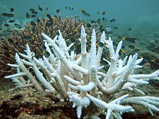
Overview
Anders Snell
Error
GPS
Dr. Rassweiler SCUBA dives and plots diseased corals on his map post dive, but the current method is not accurate

Slide 6
Anders Snell
Error
GPS

Slide 7
Key Goals
Anders Snell
The system will be able to reliably work at a depth underwater up to 10 meters
Pinpoint diver's position within 6 m. diameter
The system will be portable, capable of launching from the shore, and require minimal setup

Slide 8
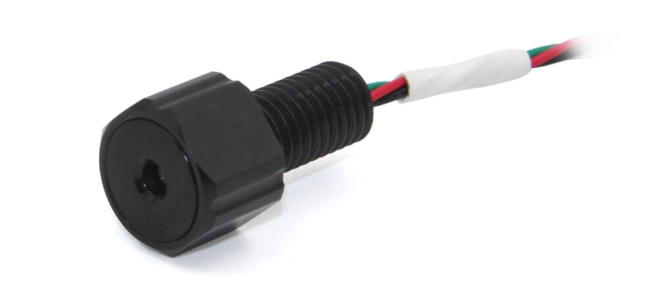
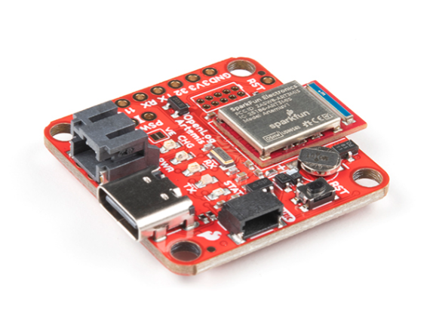
Recent Work
Anders Snell
Meet with Advisor Dr. Clark
11/14/2024
Figure 1: Barometer [3]
Continuous Research
Order Angle Sensor
11/13/2024
Test INS and Barometer
11/12/2024
Figure 2: Inertial Navigation System [4]

Slide 9
Functional Decomposition
Anders Snell
Underwater Tracking System
Sensor
Power Source
Structures
Data

Slide 10
Targets
Megan Jadush

Slide 11
Targets
Megan Jadush
Sensors

Slide 12
Targets
Megan Jadush
Sensors
Tracks diver global position (6 m.)

Slide 13
Targets
Megan Jadush
Power Source

Slide 14
Targets
Megan Jadush
Power Source
Lasts >= 90 minutes

Slide 15
Targets
Megan Jadush
Structures

Slide 16
Targets
Megan Jadush
Structures
Waterproof
Transportable

Slide 17
Targets
Megan Jadush
Data

Slide 18
Targets
Megan Jadush
Data
Transmission (9600 baud)
Storage (32 GB)

Slide 19
Concept Generation – Morphological Chart
Megan Jadush
Navigation
Drift Correction
Above Surface System
Final Variable
Specific GPS Technologies
Attitude Heading Reference System

Slide 20
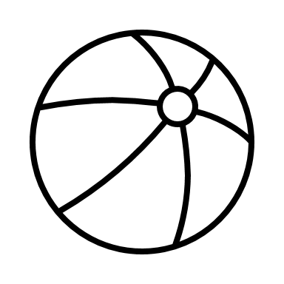
Concept Generation - Biomimicry
Megan Jadush
Harbor Seals use their whiskers to sense movement in the water
Creating a device to place at the coral to emit signal for GPS to pick up

Slide 21
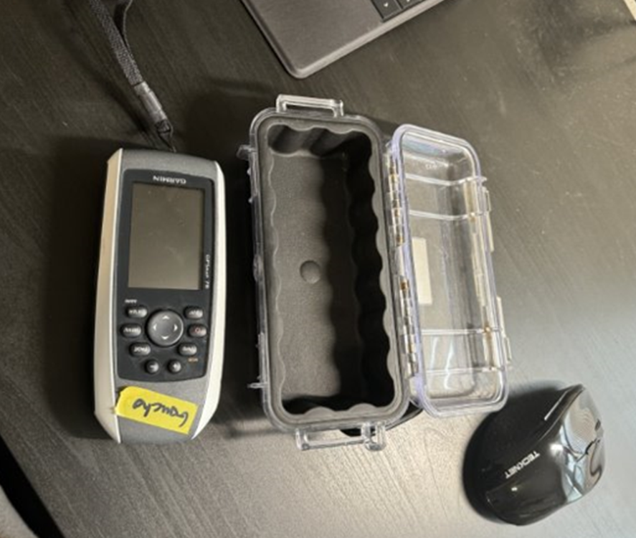
Inertial Navigation System (INS)
Anders Snell
Inertial Measurement Unit (IMU)
Attitude and Heading Reference System (AHRS)
Picture of INS goes here
Picture of INS goes here
Global Positioning System (GPS)
Global Positioning System (GPS)
Attitude and Heading Reference System (AHRS)
Linear accelerations and angular velocities are measured with accelerometers and gyroscopes
Orientation is determined with data from the IMU and a
magnetometer, ran through filter algorithms
Orientation is determined with data from the IMU and a
magnetometer, ran through filter algorithms
Positioning data from satellites used to correct cumulative positional errors (drift) of the system
Positioning data from satellites used to correct cumulative positional errors (drift) of the system
Figure 3: IMU + AHRS
Figure 4: GPS
20

Slide 22
Concept Selection- Medium Fidelity Ideas
Anders Snell
Concept 42
Concept 62
Concept 63
Concept 90
Concept 96
INS
No Angle Sensors
No Surface Device (Re-surface)
INS
Angle Sensors
Dive Watch (Depth)
INS
Angle Sensors
Rope
Measure Rope
INS
Angle Sensors
Rope with Coil
No INS
Angle Sensors
AHRS (Raft)
Barometer (Depth)

Slide 23
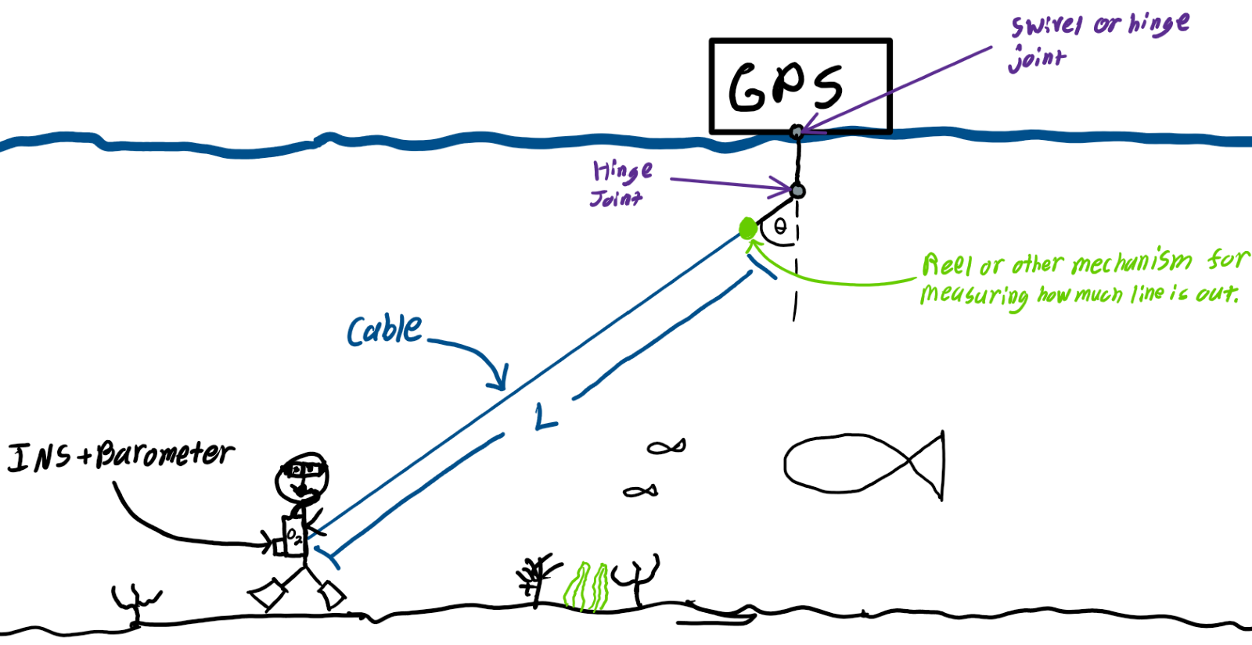
First High Fidelity Concept #33
Cody Carlson
Inertial Navigation System (INS)
Barometer
Angle sensor
GPS
Cable instead of rope
Measurement of cable length

Slide 24
Second High Fidelity Concept #55
Cody Carlson
Long range radio communication (LoRa) triangular positioning technology
Two nodes on shore and one on the ocean
Attitude & heading reference system (AHRS)
Angle sensors

Slide 25
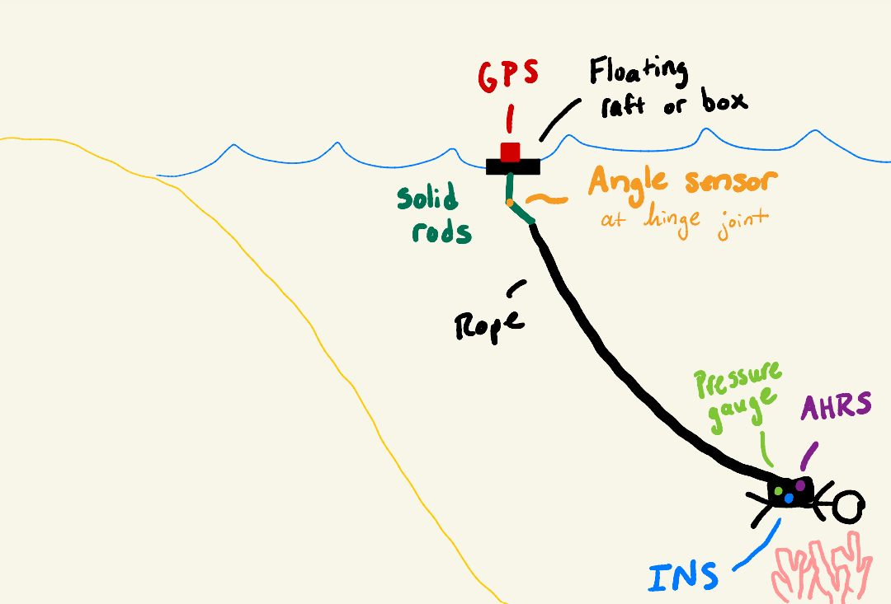
Third High Fidelity Concept #61
Cody Carlson
Inertial navigation system (INS)
Angle sensors
Attitude & heading reference system (AHRS)
GPS secured in a floating raft

Slide 26
Concept Selection
Cody Carlson
Table 1: Binary Pairwise Comparison Matrix

Slide 27
House of Quality
Cody Carlson
Track Diver Global Position
Track GPS Position
Data Transmission
Waterproofing
HoQ
Pressure Resistance

Slide 28
Concept Selection
Cody Carlson

Slide 29
Final Design: Concept 61
Cody Carlson

Slide 30
Future Work
Cody Carlson
Start on Cardboard and/or 3D printed prototype
11/22/2024
Testing of Angle Sensor
11/29/2024
Order waterproof angle sensor
12/01/2024
Continuous Research
Order JST cables for microcontroller connections
11/25/2024
Work on CAD model and electrical diagram of system
11/30/2024

Slide 31
References
Cody Carlson
[1] What is an Inertial Measurement Unit? (2024). VectorNav. https://www.vectornav.com/resources/detail/what-is-an-inertial-measurement-unit
[2] Garmin GPSMAP 78 Handheld Navigator - 010-00864-00. (2024). Marine Electronics Shop. https://www.marine-electronics-shop.com/garmin-gpsmap-78-handheld-navigator-010-00864-00/
[3] Bar02 Ultra High Resolution 10m Depth/Pressure Sensor. (n.d.). Blue Robotics. https://bluerobotics.com/store/sensors-cameras/sensors/bar02-sensor-r1-rp/
[4] SparkFun OpenLog Artemis - DEV-16832 - SparkFun Electronics. (2022, November 5). Sparkfun.com. https://www.sparkfun.com/products/16832

Slide 32
Recap
Cody Carlson
Objective
Technology
Concepts

Slide 33
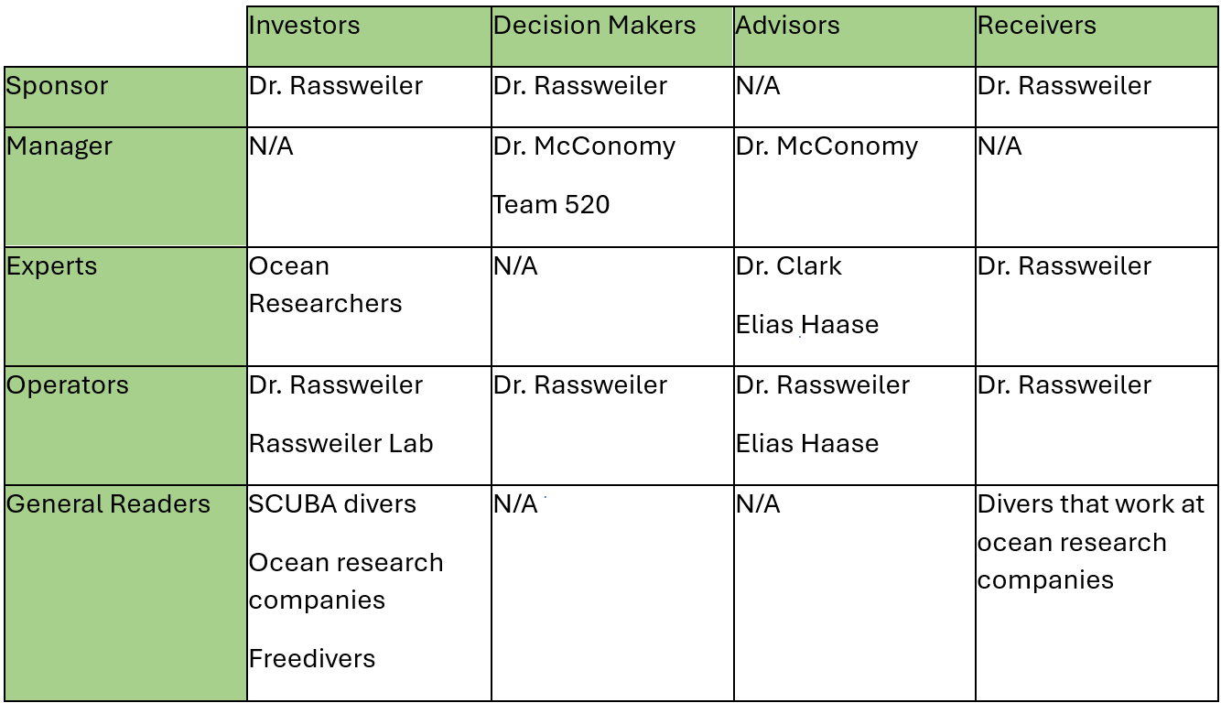
Stakeholder Matrix

Slide 34
Other Customer Needs
Customer Statements
Interpreted Needs
I go into the ocean from the shore.
The device is easy to carry straight from the shore into the ocean.
I need the device to be easy for me to use in the ocean, I don’t want to be carrying around a bunch of pieces.
The device consists of 1 or 2 small pieces.
It would never be longer than 90 minutes at a time.
The device’s battery lasts for at least 90 minutes.
The shore is very rocky and at some points clifflike.
The device is light and easy to maneuver.
The only extreme condition in the water is the wind, it is very windy.
The device still operates normally when experiencing high winds.
I have a good digital map of the area; my goal is to mark these locations onto my map to do analyses with them.
The device can log a digital location.

Slide 35
Critical Functions
Sensor
Power Source
Structures
Data
Tracks GPS Positioning
Tracks Diver Positioning
Tracks Time

Slide 36
Critical Functions
Sensor
Power Source
Structures
Data
Powers Underwater Device
Powers Data Transmission
Powers Potential Surface Device

Slide 37
Critical Functions
Sensor
Power Source
Structures
Data
Below Unit
Above Unit
Resisting Leaks
Resisiting Pressure Changes
Resisting Environmental Conditions
Endures Transportation
Resisting Temperature Changes

Slide 38
Critical Functions
Sensor
Power Source
Structures
Data
Data Transmission
Data Storage
Sends Diver Data
Receives Data From Diver
Stores System Information At Marked Times

Slide 39
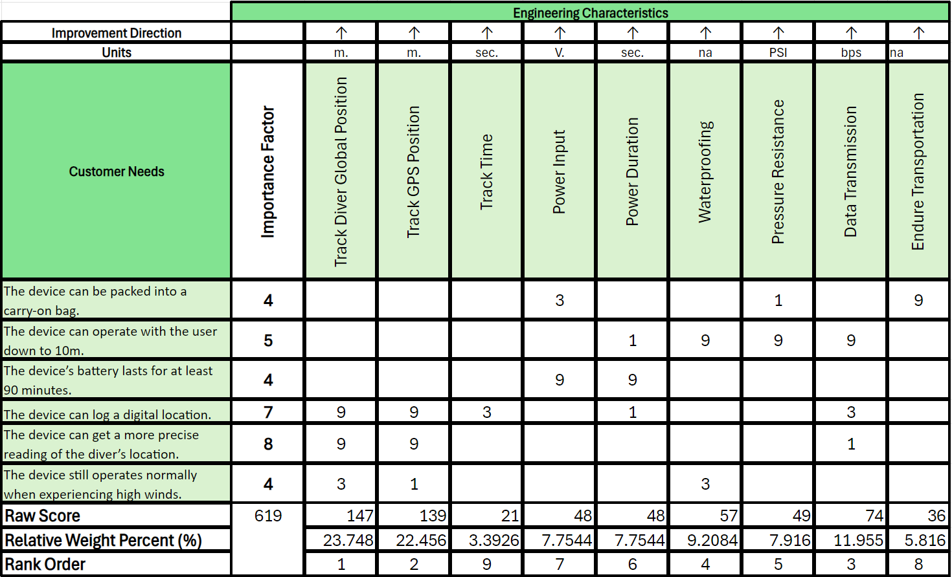
Concept Selection

Slide 40
Pugh Chart Iteration

Slide 41
Concept Selection

Slide 42
Back Up Slides

Slide 43
Slide Headline
Try to keep text at 16 pt minimum.
Try to put as few words as possible on the slide if you’re using for a presentation.
Mix and match the backgrounds as shown in this template or just use one throughout.
You can put department/unit logos in slide master at Horizontal 0.89” Vertical 6.44” From top left corner

Slide 44
Font Check
This is 10-point
This is 15–point Times
This is 20–point
This is 25–point
This is 30–point
This is 35–point
This is 40–point
This is 50–point
This is 60–point
This is 72–point
Notes:
Use at least 20-point font in Room A105, B134, and B136
Use at least 25-point font in Room B135

Slide 45
College of Engineering Color Palette
1 2 3 4
Pantone: PMS 195 C
RGB: 120, 47, 64
Hex: #782F40
CMYK:19, 90, 50, 55
1 2 3 4
Pantone: Black C
RGB: 0, 0, 0
Hex: #000000
CMYK:0, 0, 0, 100
Garnet
Black
1 2 3 4
RGB: 238, 118, 36
Hex: #EE7624
CMYK:2, 66, 99, 0
1 2 3 4
Pantone: PMS 000C
RGB: 255, 255, 255
Hex: #FFFFFF
CMYK: 0, 0, 0, 0
Fang
Orange
White
Notes:
Avoid 75% Black in B135

Slide 46
Accent Color Palette
1 2 3 4
RGB: 0, 59, 111
Hex: #003B6F
CMYK:
1 2 3 4
RGB: 0, 59, 111
Hex: #003B6F
CMYK:
1 2 3 4
RGB: 251, 236, 93
Hex: #FBEC5D
CMYK:
1 2 3 4
RGB: 219, 215, 210
Hex: #DBD7D2
CMYK:
1 2 3 4
RGB: 251, 236, 93
Hex: #FBEC5D
CMYK:
1 2 3 4
RGB: 219, 215, 210
Hex: #DBD7D2
CMYK:
Tardis Blue
Tardis Blue
Corn
Timberwolf
Corn
Timberwolf
1 2 3 4
RGB: 206, 0, 88
Hex: #CE0058
CMYK: 0, 100, 43, 12
1 2 3 4
RGB: 206, 0, 88
Hex: #CE0058
CMYK: 0, 100, 43, 12
1 2 3 4
RGB: 104, 40, 96
Hex: #682860
CMYK:
1 2 3 4
RGB: 220, 220, 220
Hex: #DCDCDC
CMYK:
Rubine Red
Rubine Red
Imperial
Gainsboro
1 2 3 4
RGB: 72, 146, 155
Hex: #48929b
CMYK:
1 2 3 4
RGB: 64, 224, 208
Hex: #40E0D0
CMYK:
1 2 3 4
RGB: 255, 139, 0
Hex: #FF8B00
CMYK:
Asagi-iro
Turquoise
American Orange
Notes:
Remove American orange add hyperlink grey
Make corn the last for b135
All work in 134 imperial move later
Tardis doesn’t work in b136

Slide 47
F7AB19
D67F15
EE7624
D64615
F73119
Analogous
6E3610
F0A16C
EE7624
6E4931
BASB1C
Monochromatic
A14508
4BED3B
EE7624
250CED
2010A1
Triad
A1470C
FF8C40
EE7624
0098A1
24E2ED
Complementary
28A164
2FED8D
EE7624
0848A1
1871ED
Split Complementary
EDAC2F
3BED93
EE7624
0C6AED
ED2F18
Double Split Complementary
ED660C
C7ED3B
EE7624
0CE1ED
A418ED
Square
BA7E09
87724A
EE7624
60EFCF
09BA61
Compound
https://color.adobe.com/create/color-wheel
AD551A
6E3610
EE7624
FA7625
D46820
Shades
Notes:
These are the variants that work well with Fang Orange. The bolded items show well on the projectors.

Slide 48
85412D
8F3831
782f40
8F3176
792D85
Analogous
C44D69
8E626D
782F40
C48796
451B25
Monochromatic
C43959
78743B
782F40
236178
43A2C4
Triad
C43959
C46078
782F40
25C43D
2F783A
Complementary
93C460
577835
782F40
39C49D
297861
Split Complementary
784435
5A783B
782F40
237860
6E2978
Double Split Complementary
782337
78683b
782F40
237830
293978
Square
AB4D32
DEBAAF
782F40
5D8555
70AB32
Compound
https://color.adobe.com/create/color-wheel
38161E
C44D69
782F40
853447
5E2532
Shades

Slide 49
A105
A105
B135 Stage Left
B135 Stage Right
B136
B134, A105
B135

Slide 50
Border Line
Border Line
Border Line
Center of White Space
Center of Slide
Middle of Slide
Middle of White Space
Edge of Branding
Border Line
Notes:
Vertical lines from top down.
Borderline and top of title. (0.5 inch)
Center of Slide (0 inch y-direction for the entire slide)
Center of Design Content (0 inch y-direction considering the title, footer, and negative space)
Bottom of Design Content (0.25 in gap to the footer. 0.75 to the bottom of the screen)
Horizontal lines from left to right
Borderline (0.5 inch)
Center of design content.
Center of slide (0 inch y-direction for the entire slide)
Borderline (0.125 inch all around)

